Slide 1
Case Study Report
Data Analysis of a Slot Game’s Player Activity
Presenter: Freddie (Haojie Chen)
October 26th, 2022

Slide 2
Summary
Player Engagement Analysis
Modeling
Catalog

Slide 3
1. Summary
Player Engagement
Situation: Overall, 41% of users re-visit in another day and 51% of users re-visit within 3 days.
Problem: From the target time period, the later the user installs the game, the less likely for the user to re-visit the game.
Possible Reasons: Quality of new users decrease overtime; Low bet yield rate discourage users
Solutions: Encourage users to spin more at a session due to the lag in the game experience;
Encourage users to purchase more coins whose coin balance before bet are under 30k.
Correlation between User Activity and Return Another Day
Conclusion: There exists moderate correlation (model accuracy rate 67.5%).
The main factors of influence are No. of Spins and No. of Sessions.
Consideration: Due to the limit of sample size and number of features, the model performance is not good enough.
More data points and features should be included to increase the model performance and generalization.
User characteristics change greatly over time, frequent training is necessary to ensure the accuracy of dealing with new data.

Slide 4
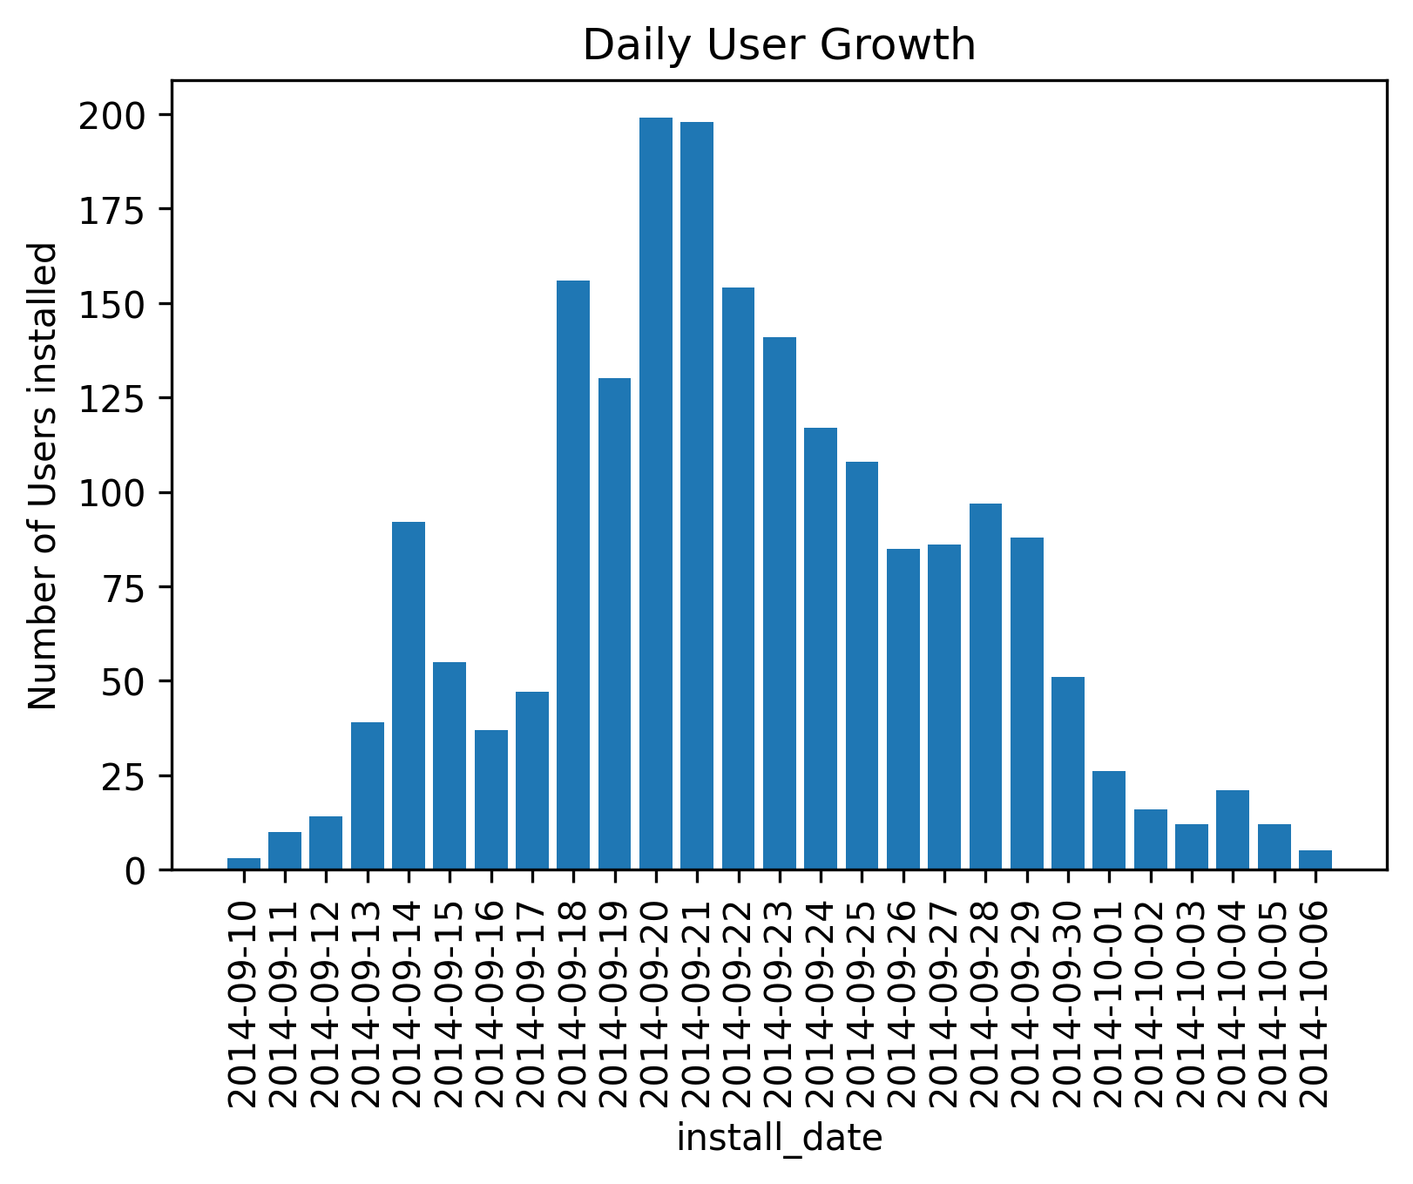
2. Player Engagement Analysis
2.1 User Growth
Assumption:
The data in this dataset is correct.
The dataset includes all the users that installed the app from 2014.09.10 to 2014.10.06
Insight:
This period can be divided into three stages: growth(09.10~09.17), boom(09.18~09.29), and decline(09.30~10.06).

Slide 5
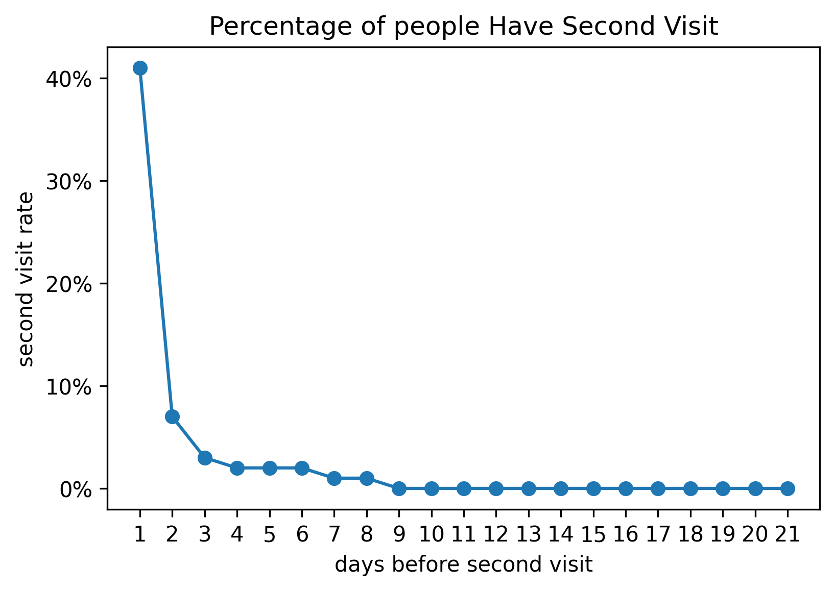
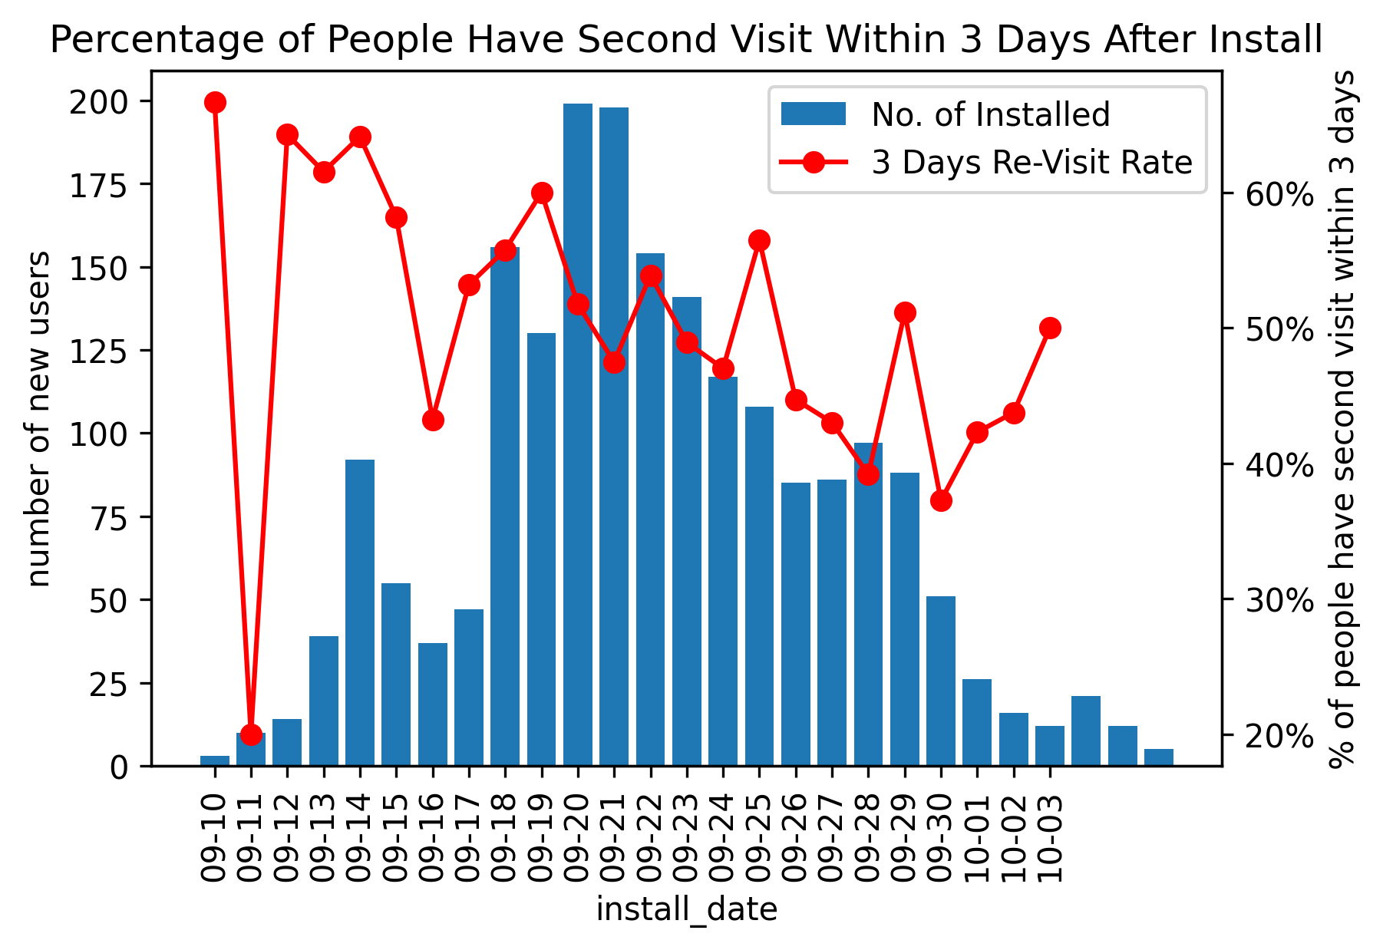
2. Player Engagement Analysis
2.2 User Second Visit Analysis
Relative Time Perspective
Absolute Time Perspective
60% of all users have second visit
41% of all users return another day
85% of revisit users return in 3 days
Percentage of revisit user in 3 days
has a decreasing trend with time

Slide 6
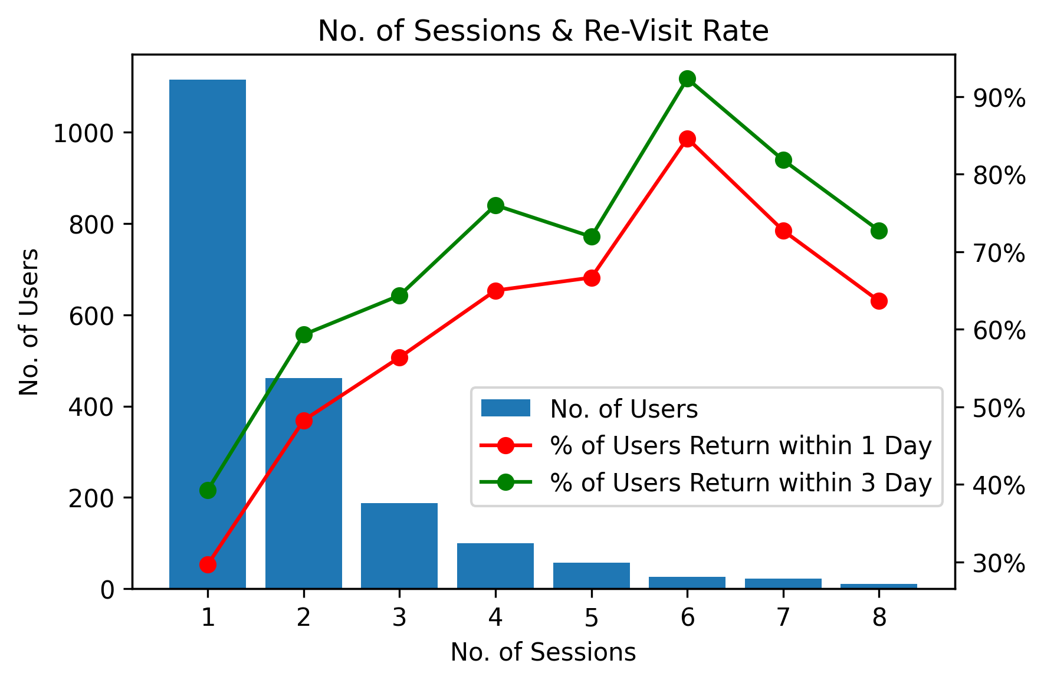
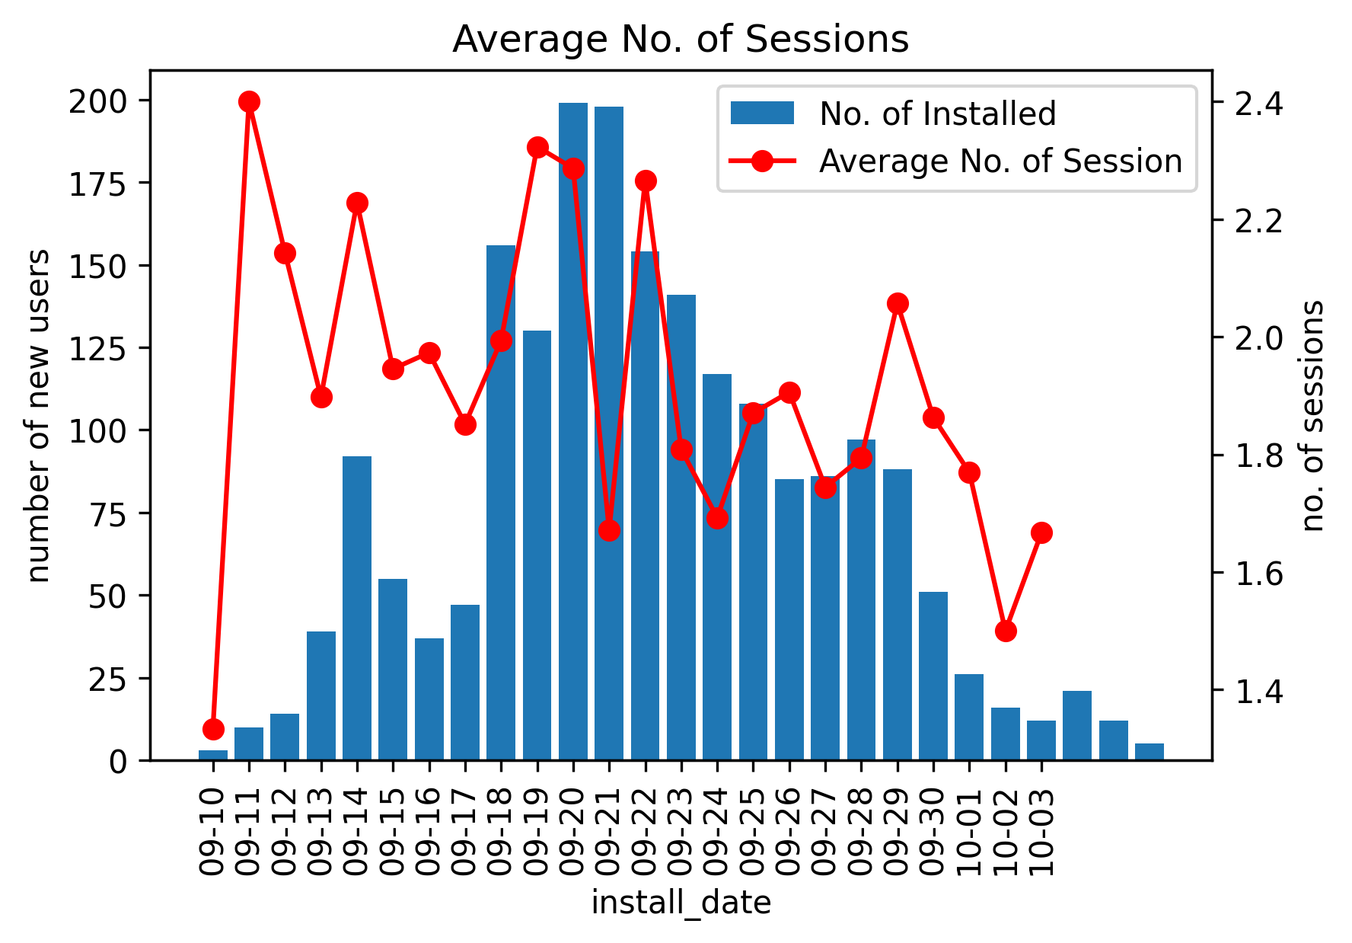
2. Player Engagement Analysis
2.2.1 Decrease in Revisit Rate is caused by User Quality
Number of Session can reflect user quality, higher No. of Sessions indicates higher Re-Visit Rate.
The decreasing trend in Avg. Number of Session explain retention decrease with time.
Possible Solution: Analyze user acquisition channels to improve user quality

Slide 7
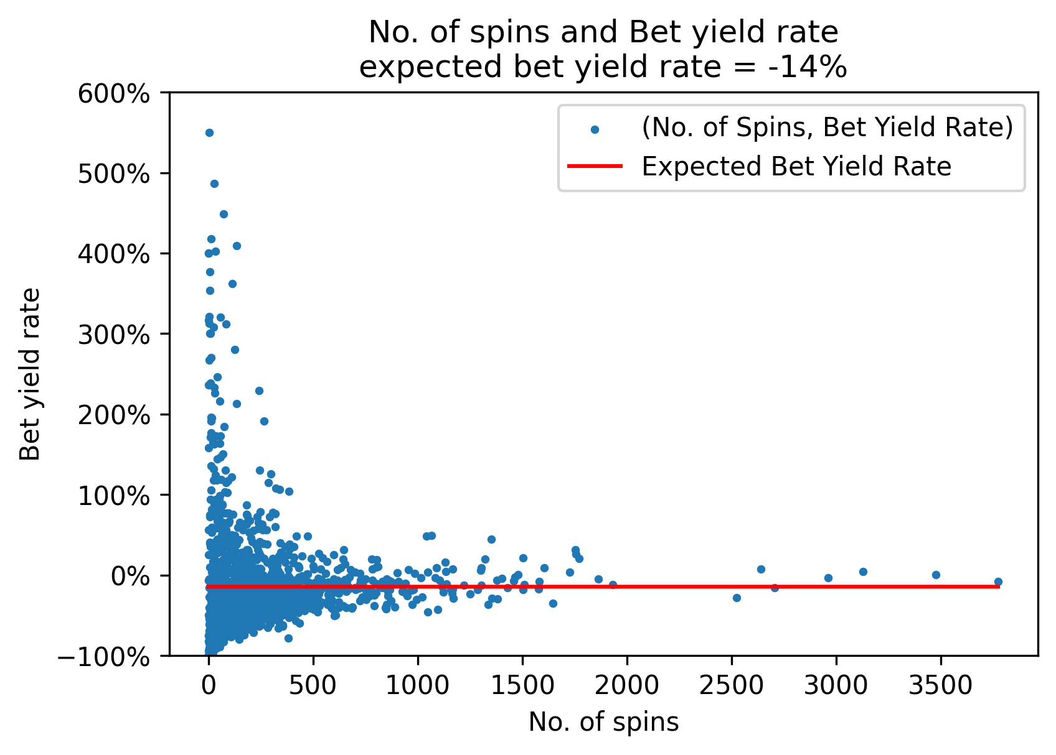
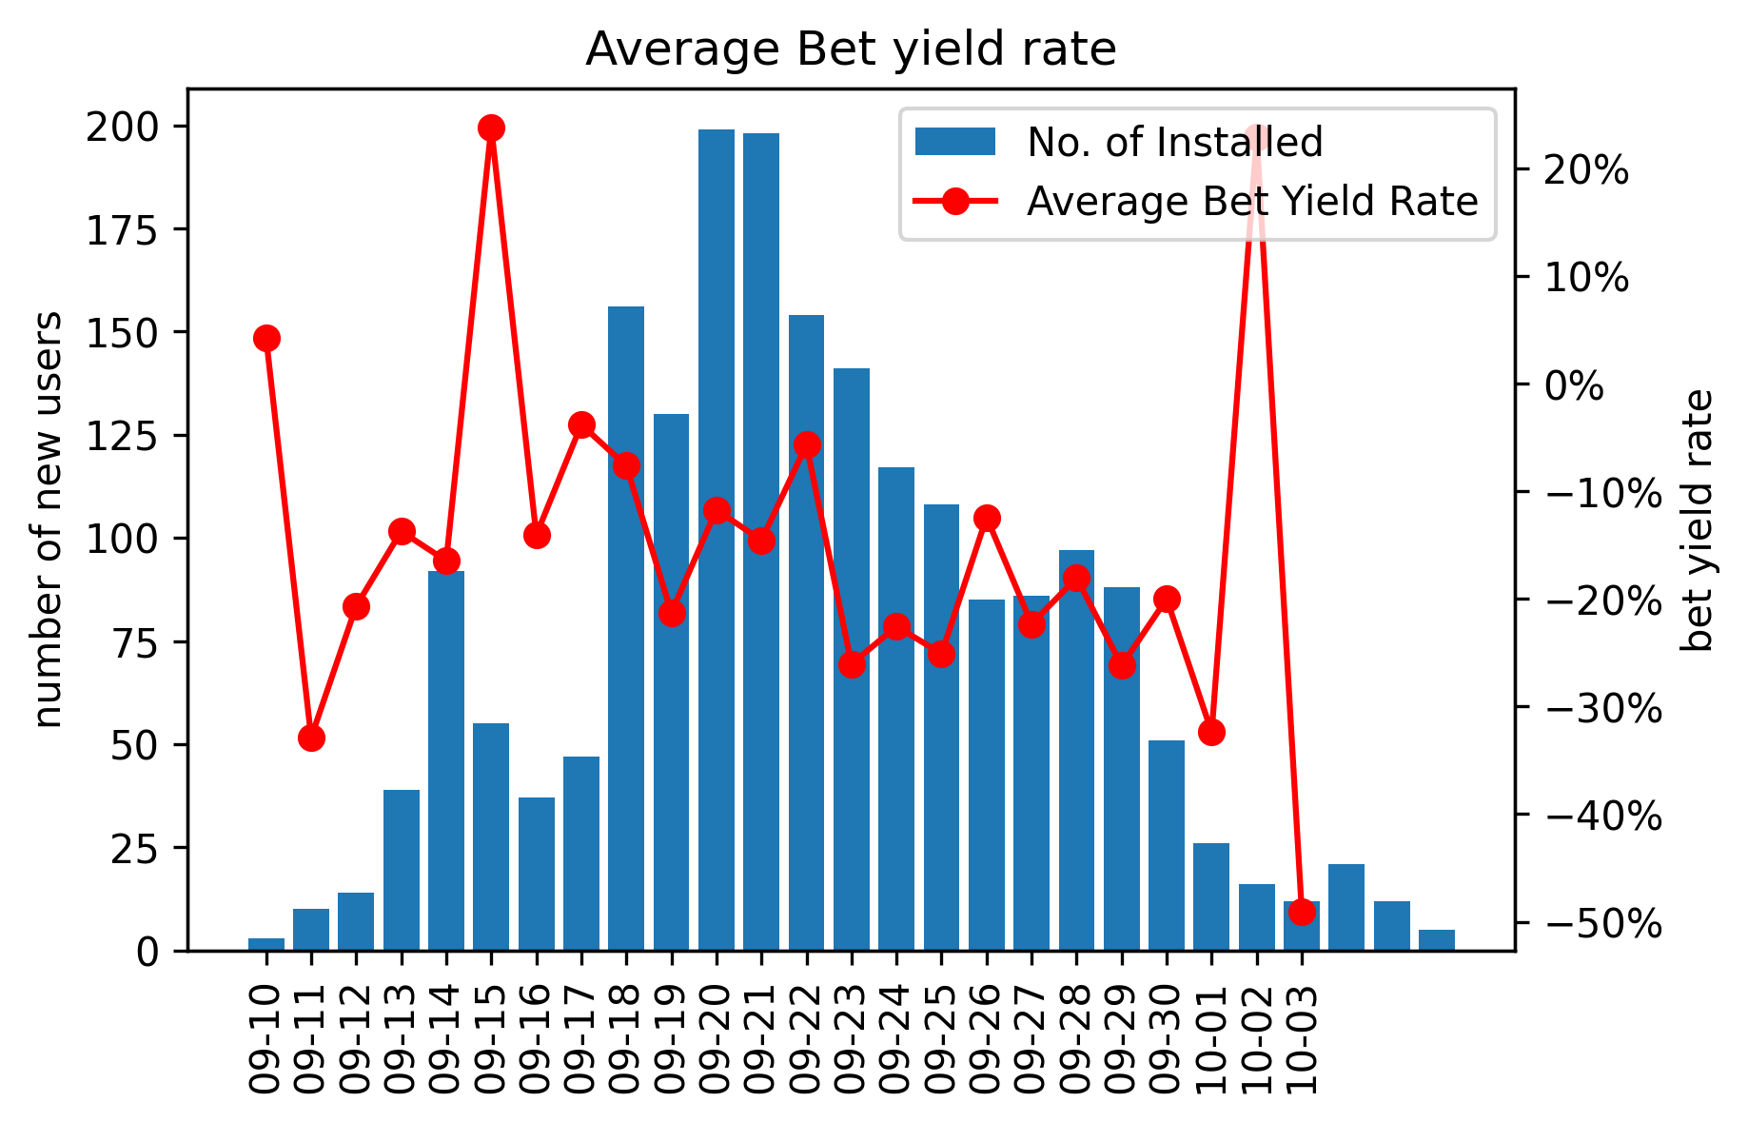
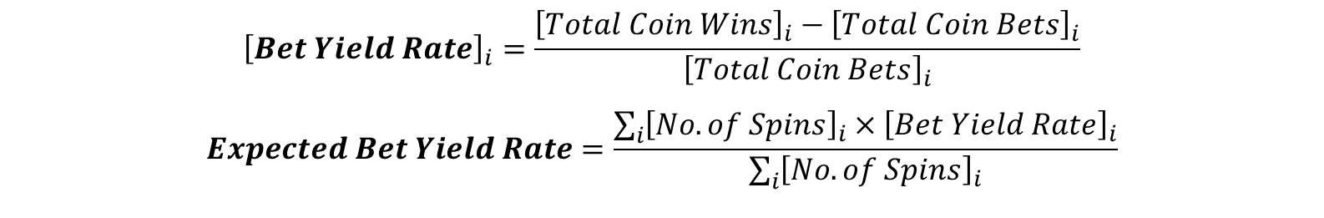
2. Player Engagement Analysis
2.2.2 Decrease in Revisit Rate is caused by low Yield Rate
$${\left[Bet Yield Rate\right]}_{i}=\frac{{\left[Total Coin Wins\right]}_{i}−{\left[Total Coin Bets\right]}_{i}}{{\left[Total Coin Bets\right]}_{i}}$$
$$Expected Bet Yield Rate=\frac{\sum_{i}{{\left[No. of Spins\right]}_{i}×{\left[Bet Yield Rate\right]}_{i}}}{\sum_{i}{{\left[No. of Spins\right]}_{i}}}$$
The expected bet yield rate is -14%, which might discourage users as the number of spins goes up.
Possible Solution: Give new users a higher yield rate or give old users bonuses

Slide 8
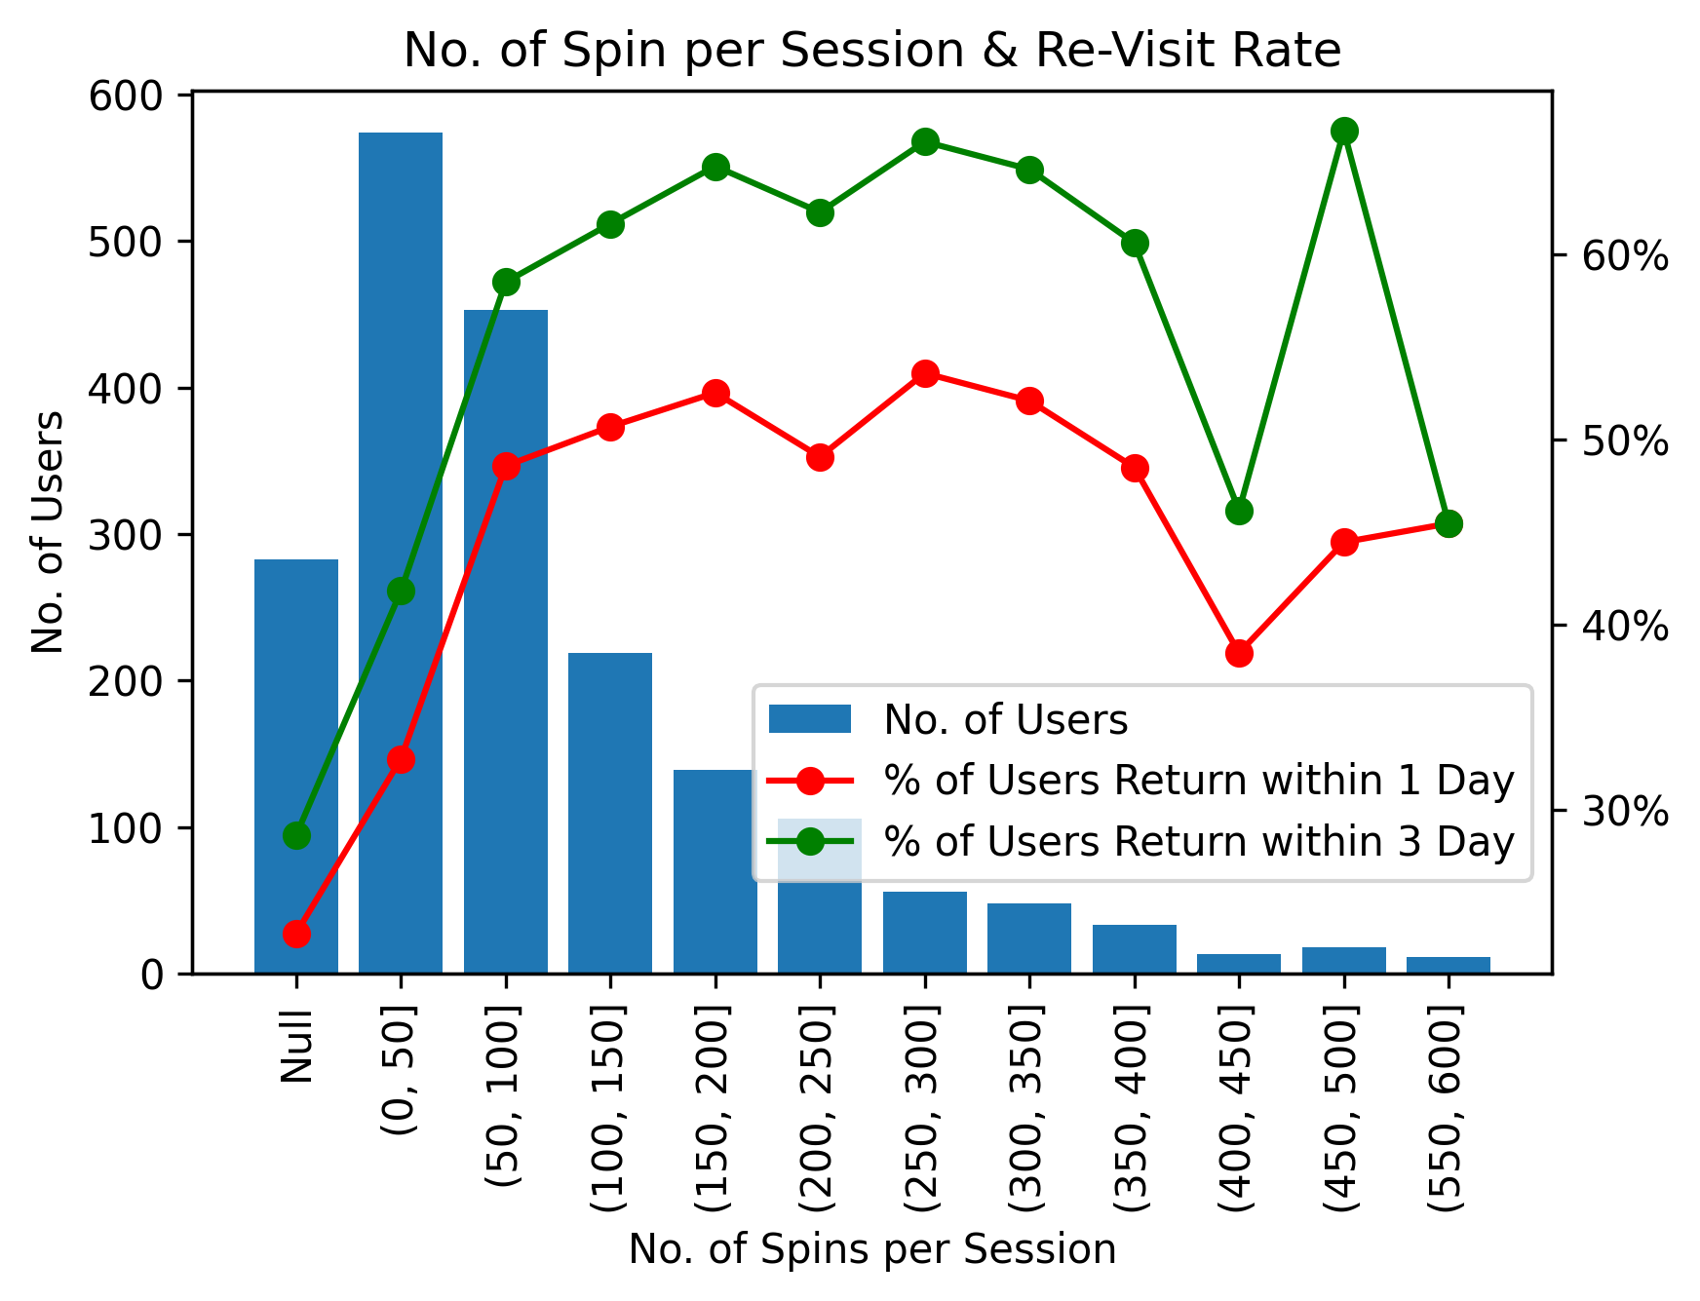
2. Player Engagement Analysis
2.3 No. of Spins per Session: Let users spin more at a session
Insight: With the increase of the No. of Spins per Session, the Re-Visit Rate first rises and then keep stable(noisy at end).
Possible Reason: Users has a lag in the game experience and needs a certain number of spins to be attracted by the game.
Advice: Encourage users with insufficient No. of Spins per Session to play more, which could enhance user experience and increase Re-Visit Rate .

Slide 9
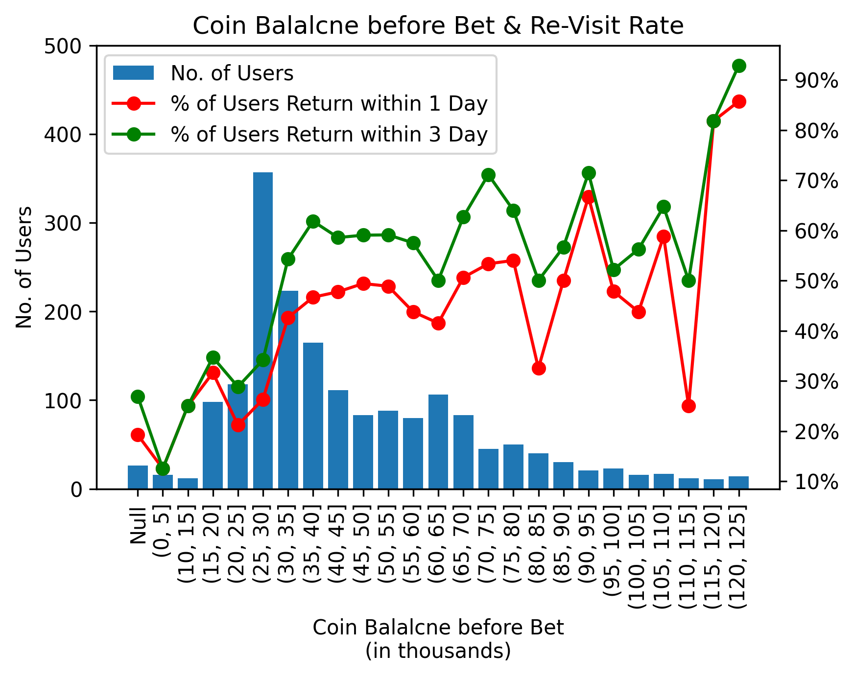
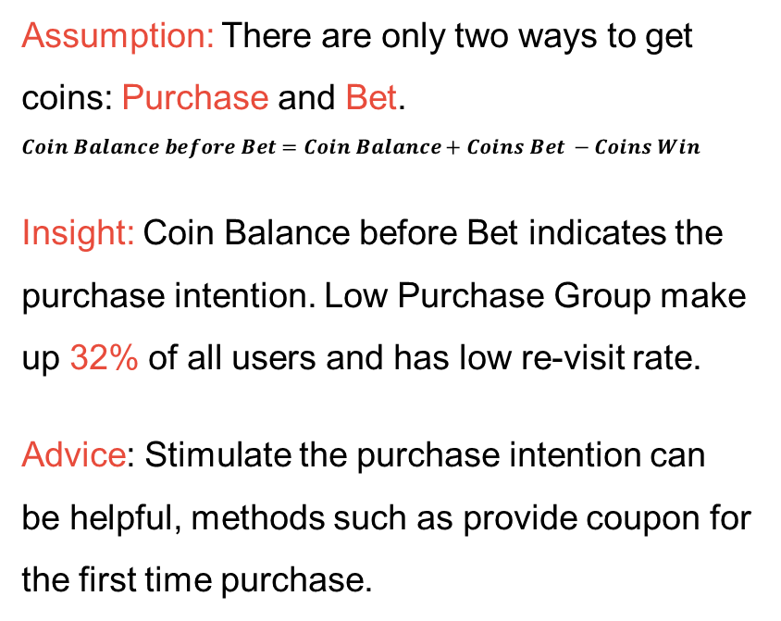
2. Player Engagement Analysis
2.4 Coin Balance before Bet indicates Purchase Intention
Assumption: There are only two ways to get coins: Purchase and Bet.
$$Coin Balance before Bet=Coin Balance+Coins Bet −Coins Win$$
Insight: Coin Balance before Bet indicates the purchase intention. Low Purchase Group make up 32% of all users and has low re-visit rate.
Advice: Stimulate the purchase intention can be helpful, methods such as provide coupon for the first time purchase.

Slide 10
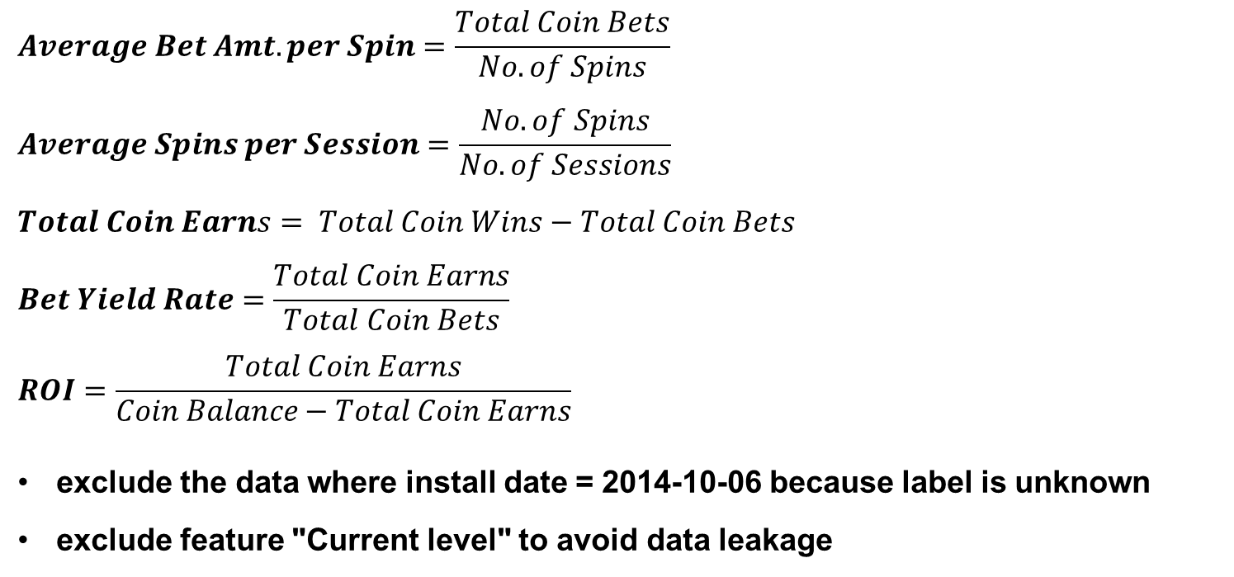
3. Modeling
3.1 Feature Engineering and Data Cleaning
$$Average Bet Amt. per Spin=\frac{Total Coin Bets}{No. of Spins}$$
$$Average Spins per Session=\frac{No. of Spins}{No. of Sessions}$$
$$Total Coin Earns= Total Coin Wins−Total Coin Bets$$
$$Bet Yield Rate=\frac{Total Coin Earns}{Total Coin Bets}$$
$$ROI=\frac{Total Coin Earns}{Coin Balance−Total Coin Earns}$$
exclude the data where install date = 2014-10-06 because label is unknown
exclude feature "Current level" to avoid data leakage

Slide 11
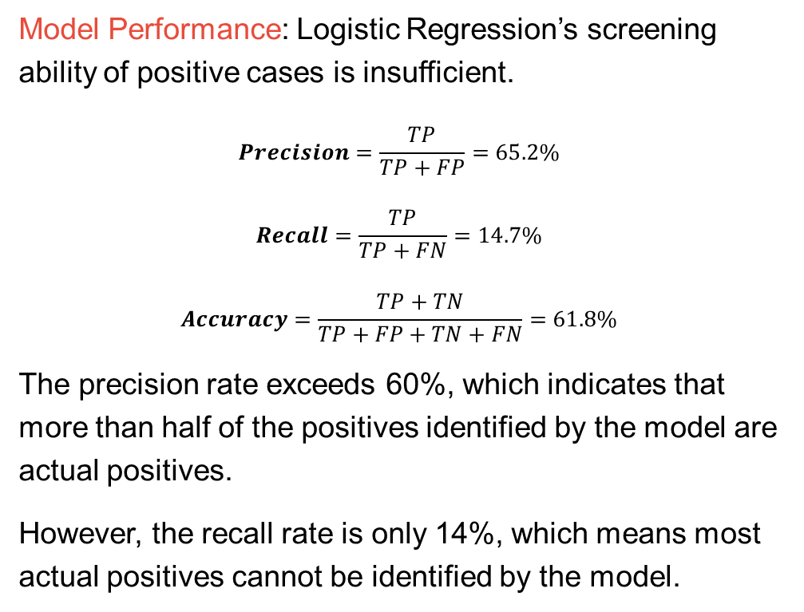
3. Modeling
3.2 Logistic Regression
Model Performance: Logistic Regression’s screening ability of positive cases is insufficient.
$$Precision=\frac{TP}{TP+FP}=65.2\%$$
$$Recall=\frac{TP}{TP+FN}=14.7\%$$
$$Accuracy=\frac{TP+TN}{TP+FP+TN+FN}=61.8\%$$
The precision rate exceeds 60%, which indicates that more than half of the positives identified by the model are actual positives.
However, the recall rate is only 14%, which means most actual positives cannot be identified by the model.
Confusion Matrix |  | Prediction Condition
 |  | come back another day | not come back another day
Actual Condition | come back another day | TP 120 | FN 697 | Recall 14.7%
 | not come back another day | FP 64 | TN 1113
 |  | Precision 65.2% |  | Accuracy 61.8%

Slide 12
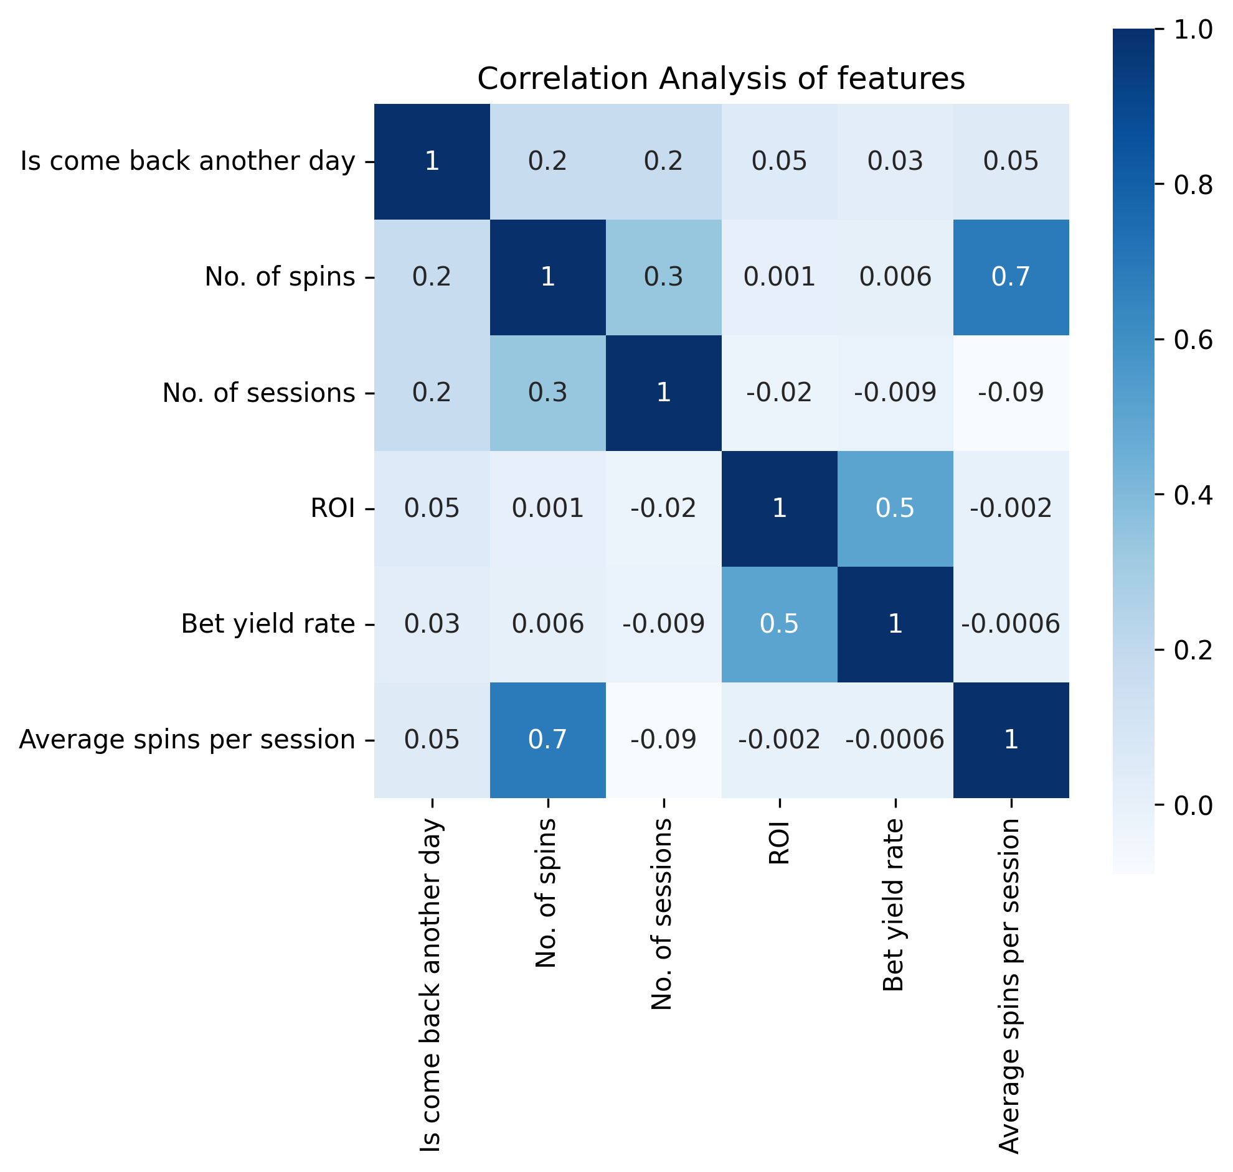
3. Modeling
3.2 Logistic Regression
Insights:
No. of Spins and No. of Sessions are most influential features in the model.
The correlation coefficient between No. of Spins and No. of Sessions is 0.3, indicating the existence of low correlation between these two features
Feature Importance Rank
Feature | Coefficient
No. of spins | 3.676256
No. of sessions | 2.703804
ROI | 0.810488
Bet yield rate | 0.680844
Average spins per session | -0.457461

Slide 13
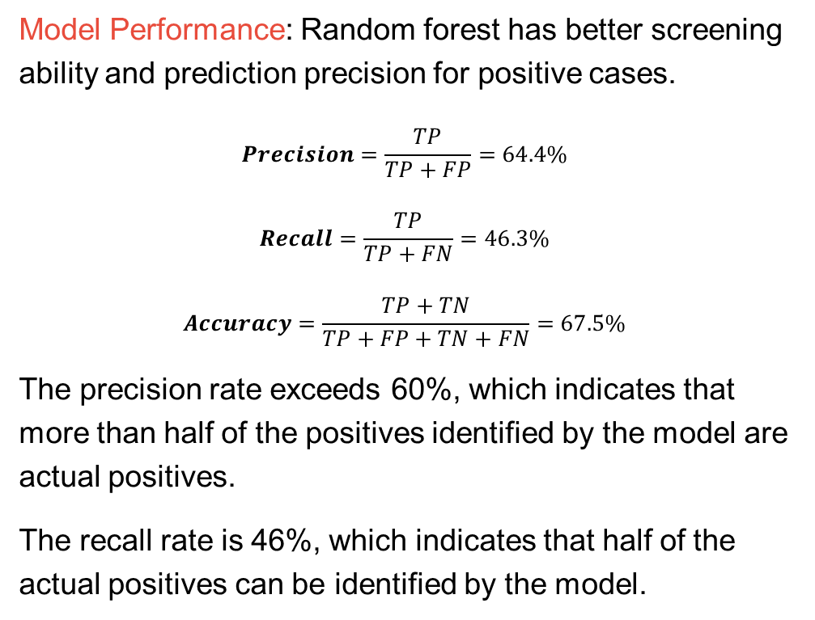
3. Modeling
3.3 Random Forest
Model Performance: Random forest has better screening ability and prediction precision for positive cases.
$$Precision=\frac{TP}{TP+FP}=64.4\%$$
$$Recall=\frac{TP}{TP+FN}=46.3\%$$
$$Accuracy=\frac{TP+TN}{TP+FP+TN+FN}=67.5\%$$
The precision rate exceeds 60%, which indicates that more than half of the positives identified by the model are actual positives.
The recall rate is 46%, which indicates that half of the actual positives can be identified by the model.
Confusion Matrix |  | Prediction Condition
 |  | come back another day | not come back another day
Actual Condition | come back another day | TP 378 | FN 439 | Recall 46.3%
 | not come back another day | FP 209 | TN 968
 |  | Precision 64.4% |  | Accuracy 67.5%

Slide 14
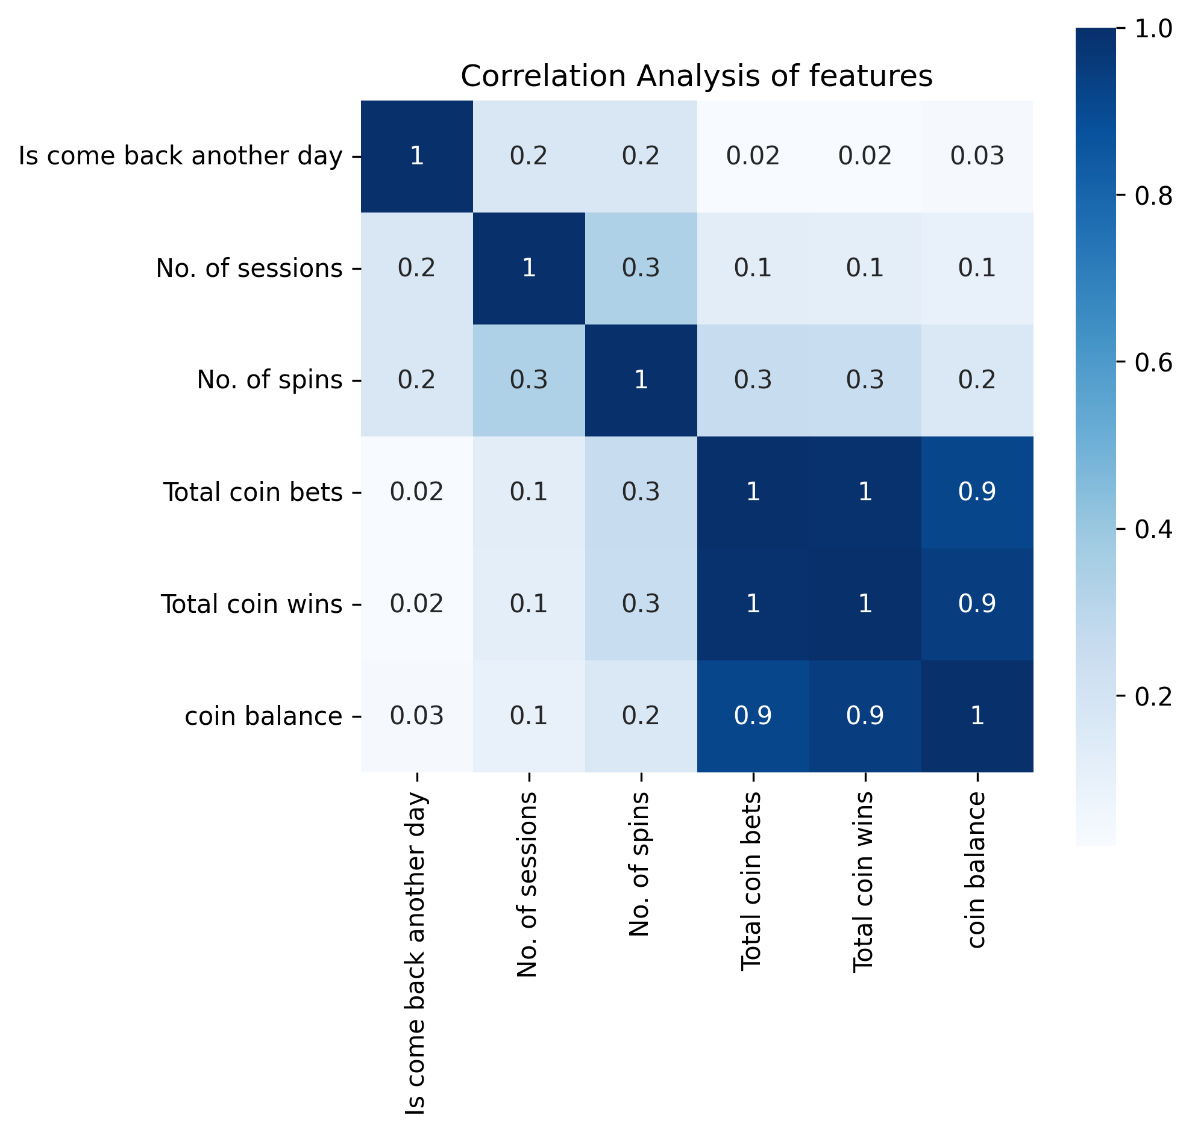
3. Modeling
3.3 Random Forest
Insights:
No. of Sessions, No. of Spins, and Total coin bets are the feature that contributes the most to the model.
No. of Sessions and No. of Spins have weak correlation with the target(is come back another day).
Total coin bets, Total coin wins, and coin balance are highly correlated with each other.
Feature Importance Rank
Feature | VIM
No. of sessions | 0.244714
No. of spins | 0.195443
Total coin bets | 0.144737
Total coin wins | 0.088844
coin balance | 0.080992

Slide 15
3. Modeling
3.4 Conclusion and Consideration
Conclusion: There exists moderate correlation between user activity and the likelihood to come back to the game another day.
Random forest can screen out around 50% users that come back to the game another day.
Random forest has over 50% of sure that the prediction match the fact.
Consideration:
Small sample size increase the chance of overfitting, even if I limit the model by regularization and pruning.
The number of features limits the model performance, and more features may improve model performance.
User characteristics change greatly over time, frequent training is necessary to ensure the accuracy of dealing with new data.

